Slide 1
Programming Fundamentals
By
Shazmeen Batool

Slide 2
Today’s Lecture
Reading Input from the Keyboard
Assignment Statements and Assignment Expressions
Mathematical Operator and their Precedence

Slide 3
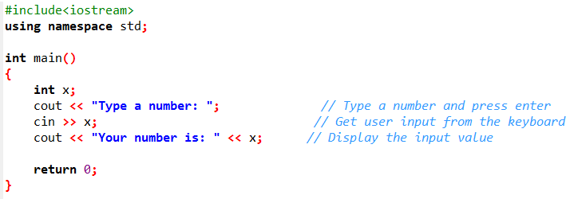

Reading Input from the Keyboard
You can use the cin object to read input from the keyboard.

Slide 4
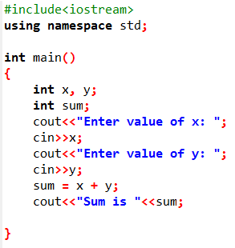
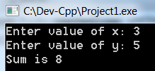
Activity
The user must input two numbers, calculate and print its sum
Output:

Slide 5
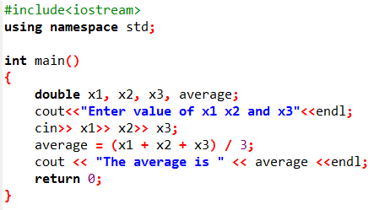
Reading Multiple Input in One Statement

Slide 6
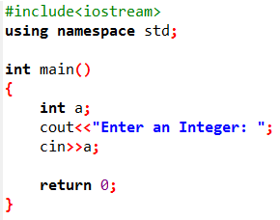
Activity
Prompt the user to enter an integer. End your prompting message with a colon (:) followed by a space and leave the cursor positioned after the space.
Read an integer from the user at the keyboard and store it in integer variable a.

Slide 7
What is an Expression in C++?
An expression is a valid arrangement of variables, constants, and operators.
In C++, each expression can be evaluated to compute a value of a given type
In C++, an expression can be:
A variable or a constant (count, 100)
An operation (a + b, a * 2)
Function call (getRectangleArea(2, 4))

Slide 8
Assignment Operator
An operator to give (assign) a value to a variable.
Denote as ‘=‘
Only variable can be on the left side.
An expression is on the right side.
Variables keep their assigned values until changed by another assignment statement or by reading in a new value.

Slide 9
Assignment Operator Syntax
Variable = Expression
First, expression on right is evaluated.
Then the resulting value is stored in the memory location of Variable on left.

Slide 10
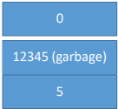
Assignment Operator Mechanism
Example:
int count = 0;
int starting;
starting = count + 5;

Slide 11
Arithmetic Operators
Operators: +, -, *, /
For floating numbers, the result as same as Math operations.
Note: On integer division the result is an integer. 7/2 is 3.
% (remainder or modulo) is the special operator just for integer. It yields an integer as the result. 7%2 is 1.
Both / and % can only be used for positive integers.
Precedence rule is similar to Math.

Slide 12
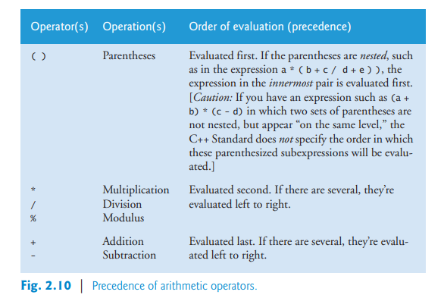
Operator Precedence

Slide 13
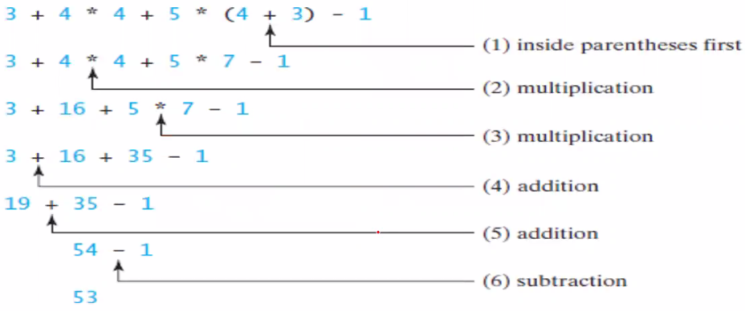
Evaluating an Expression and Operator Precedence

Slide 14
Activity
State the order of evaluation of the operators in each of the following C++ statements and show the value of x after each statement is performed.
x = 7 + 3 * 6 / 2 - 1;
x = 2 % 2 + 2 * 2 - 2 / 2;
x = ( 3 * 9 * ( 3 + ( 9 * 3 / ( 3 ) ) ) );
x = 15
x = 3
x = 324

Slide 15
Activity
Write a program that converts a Fahrenheit degree to Celsius using the formula celsius = (5/9)(fahrenheit – 32)

Slide 16
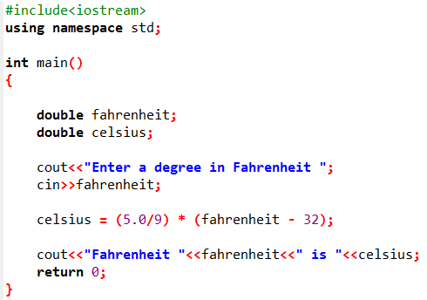


Slide 17

Integer versus decimal division
Be careful when applying division. Division of two integers yields an integer in C++.
$\frac{5}{9}$is translated to 5.0 / 9 instead of 5 / 9 in line 12 because 5 / 9 yields 0 in C++.

Slide 18
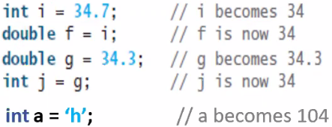
Numeric Type Conversions
Floating-point numbers can be converted into integers using explicit casting.

